Slide 1


SQL Multiple tables queries
CS3083-B Prof. Arfaoui

Slide 2

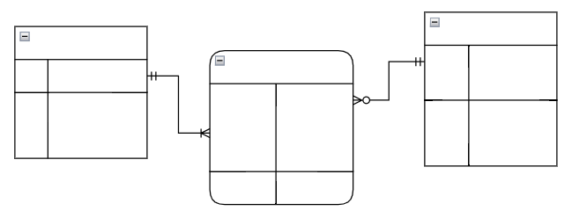


Database Design Process
Interact with stakeholders to characterize the data (requirement specification)
Translate requirements into
conceptual model (E-R diagrams)
Convert the model to relational model
(schema and constraints)
Normalize and develop
conceptual (logical) schema of the database
Implement physical schema
(SQL clauses, partitioning and indexing)

Slide 3
LAST Time:
  Aggregate Functions
    Group by
    Having
  Null Values
[A. Silberschatz, H. F. Korth, S. Sudarshan, Database System Concepts, Ch.3.7 and Ch. 5.5]

Slide 4
TODAY
What if we need data from multiple tables?
How do we describe a relationship between tables?
How do we realize combinations of data?.
More SQL
  Multiple Relations Queries
    Subqueries
    Joins
[A. Silberschatz, H. F. Korth, S. Sudarshan, Database System Concepts, Ch.4.1]
[ https://www.dofactory.com/sql/join ]

Slide 5
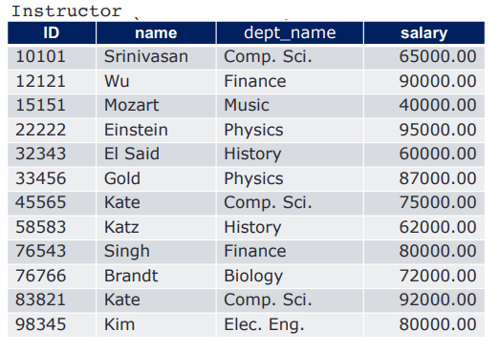
Recap 1: Aggregation
Find average salary for each department
SELECT dept_name, AVG(salary)
FROM instructor
GROUP BY dept_name;

Slide 6
Recap 2: Aggregation
Find average salary for each department
that is greater than 70000
SELECT dept_name, AVG(salary)
FROM instructor
GROUP BY dept_name
HAVING AVG(salary) > 70000;

Slide 7
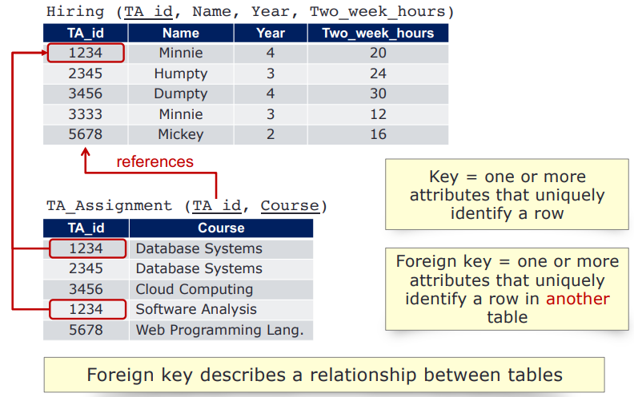
Recap: Primary Keys, Foreign Keys

Slide 8
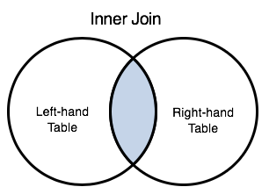
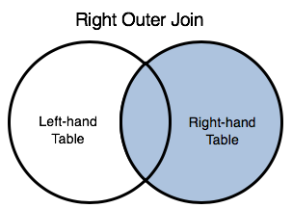
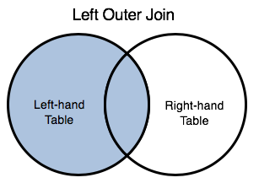
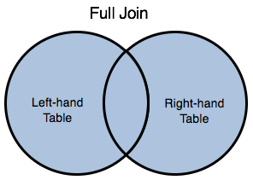
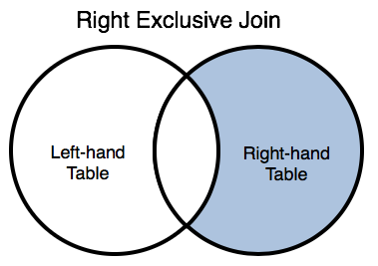
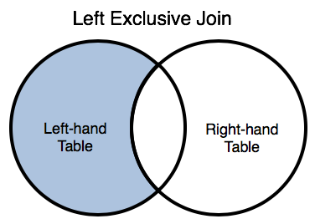
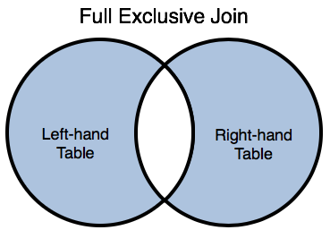
SQL JOIN
Combine related tables or sets of data on key values
All tables (or relations) must have a unique identifier (primary key)
Any related tables must contain a copy of the unique identifier (foreign key) from the related table

Slide 9
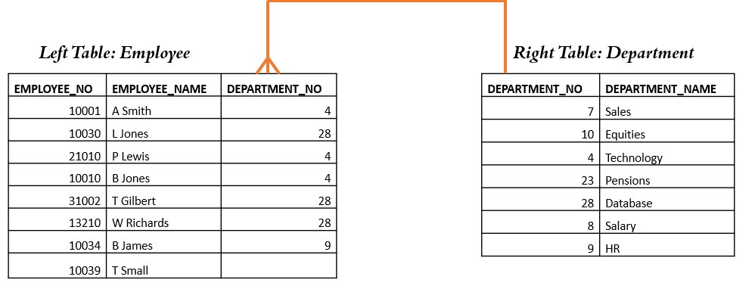
Let us start with few questions
Consider the following two tables.
List all employees who work for department with No 4.

Slide 10
One more question
list all employees (names) and their departments (names).

Slide 11
Multiple table query
Databases perform a join whenever multiple tables appear in the FROM clause of the query.
Most join queries contain WHERE clause conditions that compare two columns, each from a different table. Such a condition is called a join condition.
An equijoin is a join with a join condition containing an equality operator. An equijoin combines rows that have equivalent values for the specified columns.

Slide 12
INNER JOIN
An inner join is a join of two or more tables that returns only those rows that satisfy the join condition.
It returns records that have matching values in both tables
Syntax:
SELECT column_name(s)
FROM tableL
INNER JOIN tableR
ON tableL.column_name = tableR.column_name;

Slide 13
Left Table: Employee
Right Table: Department
EMPLOYEE_NO | EMPLOYEE_NAME | DEPARTMENT_NO
10001 | A Smith | 4
10030 | L Jones | 28
21010 | P Lewis | 4
10010 | B Jones | 4
31002 | T Gilbert | 28
13210 | W Richards | 28
10034 | B James | 9
10039 | T Small
DEPARTMENT_NO | DEPARTMENT_NAME
7 | Sales
10 | Equities
4 | Technology
23 | Pensions
28 | Database
8 | Salary
9 | HR
Employee INNER JOIN Department
SQL:
SELECT e.*, d.*
FROM Employee e
INNER JOIN Department d
ON d.Department_No = e.Department_No;

Slide 14


Employee
Department
EMPLOYEE_NO | EMPLOYEE_NAME | DEPARTMENT_NO
10001 | A Smith | 4
10030 | L Jones | 28
21010 | P Lewis | 4
10010 | B Jones | 4
31002 | T Gilbert | 28
13210 | W Richards | 28
10034 | B James | 9
10039 | T Small
DEPARTMENT_NO | DEPARTMENT_NAME
7 | Sales
10 | Equities
4 | Technology
23 | Pensions
28 | Database
8 | Salary
9 | HR
Result set

Slide 15
Employee
Department
EMPLOYEE_NO | EMPLOYEE_NAME | DEPARTMENT_NO
10001 | A Smith | 4
10030 | L Jones | 28
21010 | P Lewis | 4
10010 | B Jones | 4
31002 | T Gilbert | 28
13210 | W Richards | 28
10034 | B James | 9
10039 | T Small
DEPARTMENT_NO | DEPARTMENT_NAME
7 | Sales
10 | Equities
4 | Technology
23 | Pensions
28 | Database
8 | Salary
9 | HR
Result set

Slide 16
Employee
Department
EMPLOYEE_NO | EMPLOYEE_NAME | DEPARTMENT_NO
10001 | A Smith | 4
10030 | L Jones | 28
21010 | P Lewis | 4
10010 | B Jones | 4
31002 | T Gilbert | 28
13210 | W Richards | 28
10034 | B James | 9
10039 | T Small
DEPARTMENT_NO | DEPARTMENT_NAME
7 | Sales
10 | Equities
4 | Technology
23 | Pensions
28 | Database
8 | Salary
9 | HR
EMPLOYEE_NO | EMPLOYEE_NAME | DEPARTMENT_NO | DEPARTMENT_NO | DEPARTMENT_NAME
10001 | A Smith | 4 | 4 | Technology
Result set

Slide 17
Employee
Department
EMPLOYEE_NO | EMPLOYEE_NAME | DEPARTMENT_NO
10001 | A Smith | 4
10030 | L Jones | 28
21010 | P Lewis | 4
10010 | B Jones | 4
31002 | T Gilbert | 28
13210 | W Richards | 28
10034 | B James | 9
10039 | T Small
DEPARTMENT_NO | DEPARTMENT_NAME
7 | Sales
10 | Equities
4 | Technology
23 | Pensions
28 | Database
8 | Salary
9 | HR
EMPLOYEE_NO | EMPLOYEE_NAME | DEPARTMENT_NO | DEPARTMENT_NO | DEPARTMENT_NAME
10001 | A Smith | 4 | 4 | Technology
Result set

Slide 18
Employee
Department
EMPLOYEE_NO | EMPLOYEE_NAME | DEPARTMENT_NO
10001 | A Smith | 4
10030 | L Jones | 28
21010 | P Lewis | 4
10010 | B Jones | 4
31002 | T Gilbert | 28
13210 | W Richards | 28
10034 | B James | 9
10039 | T Small
DEPARTMENT_NO | DEPARTMENT_NAME
7 | Sales
10 | Equities
4 | Technology
23 | Pensions
28 | Database
8 | Salary
9 | HR
EMPLOYEE_NO | EMPLOYEE_NAME | DEPARTMENT_NO | DEPARTMENT_NO | DEPARTMENT_NAME
10001 | A Smith | 4 | 4 | Technology
Result set

Slide 19
Employee
Department
EMPLOYEE_NO | EMPLOYEE_NAME | DEPARTMENT_NO
10001 | A Smith | 4
10030 | L Jones | 28
21010 | P Lewis | 4
10010 | B Jones | 4
31002 | T Gilbert | 28
13210 | W Richards | 28
10034 | B James | 9
10039 | T Small
DEPARTMENT_NO | DEPARTMENT_NAME
7 | Sales
10 | Equities
4 | Technology
23 | Pensions
28 | Database
8 | Salary
9 | HR
EMPLOYEE_NO | EMPLOYEE_NAME | DEPARTMENT_NO | DEPARTMENT_NO | DEPARTMENT_NAME
10001 | A Smith | 4 | 4 | Technology
Result set

Slide 20
Employee
Department
EMPLOYEE_NO | EMPLOYEE_NAME | DEPARTMENT_NO
10001 | A Smith | 4
10030 | L Jones | 28
21010 | P Lewis | 4
10010 | B Jones | 4
31002 | T Gilbert | 28
13210 | W Richards | 28
10034 | B James | 9
10039 | T Small
DEPARTMENT_NO | DEPARTMENT_NAME
7 | Sales
10 | Equities
4 | Technology
23 | Pensions
28 | Database
8 | Salary
9 | HR
EMPLOYEE_NO | EMPLOYEE_NAME | DEPARTMENT_NO | DEPARTMENT_NO | DEPARTMENT_NAME
10001 | A Smith | 4 | 4 | Technology
Result set

Slide 21
Employee
Department
EMPLOYEE_NO | EMPLOYEE_NAME | DEPARTMENT_NO
10001 | A Smith | 4
10030 | L Jones | 28
21010 | P Lewis | 4
10010 | B Jones | 4
31002 | T Gilbert | 28
13210 | W Richards | 28
10034 | B James | 9
10039 | T Small
DEPARTMENT_NO | DEPARTMENT_NAME
7 | Sales
10 | Equities
4 | Technology
23 | Pensions
28 | Database
8 | Salary
9 | HR
EMPLOYEE_NO | EMPLOYEE_NAME | DEPARTMENT_NO | DEPARTMENT_NO | DEPARTMENT_NAME
10001 | A Smith | 4 | 4 | Technology
Result set

Slide 22
Employee
Department
EMPLOYEE_NO | EMPLOYEE_NAME | DEPARTMENT_NO
10001 | A Smith | 4
10030 | L Jones | 28
21010 | P Lewis | 4
10010 | B Jones | 4
31002 | T Gilbert | 28
13210 | W Richards | 28
10034 | B James | 9
10039 | T Small
DEPARTMENT_NO | DEPARTMENT_NAME
7 | Sales
10 | Equities
4 | Technology
23 | Pensions
28 | Database
8 | Salary
9 | HR
EMPLOYEE_NO | EMPLOYEE_NAME | DEPARTMENT_NO | DEPARTMENT_NO | DEPARTMENT_NAME
10001 | A Smith | 4 | 4 | Technology
Result set

Slide 23
Employee
Department
EMPLOYEE_NO | EMPLOYEE_NAME | DEPARTMENT_NO
10001 | A Smith | 4
10030 | L Jones | 28
21010 | P Lewis | 4
10010 | B Jones | 4
31002 | T Gilbert | 28
13210 | W Richards | 28
10034 | B James | 9
10039 | T Small
DEPARTMENT_NO | DEPARTMENT_NAME
7 | Sales
10 | Equities
4 | Technology
23 | Pensions
28 | Database
8 | Salary
9 | HR
EMPLOYEE_NO | EMPLOYEE_NAME | DEPARTMENT_NO | DEPARTMENT_NO | DEPARTMENT_NAME
10001 | A Smith | 4 | 4 | Technology
Result set

Slide 24
Employee
Department
EMPLOYEE_NO | EMPLOYEE_NAME | DEPARTMENT_NO
10001 | A Smith | 4
10030 | L Jones | 28
21010 | P Lewis | 4
10010 | B Jones | 4
31002 | T Gilbert | 28
13210 | W Richards | 28
10034 | B James | 9
10039 | T Small
DEPARTMENT_NO | DEPARTMENT_NAME
7 | Sales
10 | Equities
4 | Technology
23 | Pensions
28 | Database
8 | Salary
9 | HR
EMPLOYEE_NO | EMPLOYEE_NAME | DEPARTMENT_NO | DEPARTMENT_NO | DEPARTMENT_NAME
10001 | A Smith | 4 | 4 | Technology
Result set

Slide 25
Employee
Department
EMPLOYEE_NO | EMPLOYEE_NAME | DEPARTMENT_NO
10001 | A Smith | 4
10030 | L Jones | 28
21010 | P Lewis | 4
10010 | B Jones | 4
31002 | T Gilbert | 28
13210 | W Richards | 28
10034 | B James | 9
10039 | T Small
DEPARTMENT_NO | DEPARTMENT_NAME
7 | Sales
10 | Equities
4 | Technology
23 | Pensions
28 | Database
8 | Salary
9 | HR
EMPLOYEE_NO | EMPLOYEE_NAME | DEPARTMENT_NO | DEPARTMENT_NO | DEPARTMENT_NAME
10001 | A Smith | 4 | 4 | Technology
10030 | L Jones | 28 | 28 | Database
Result set

Slide 26
Employee
Department
EMPLOYEE_NO | EMPLOYEE_NAME | DEPARTMENT_NO
10001 | A Smith | 4
10030 | L Jones | 28
21010 | P Lewis | 4
10010 | B Jones | 4
31002 | T Gilbert | 28
13210 | W Richards | 28
10034 | B James | 9
10039 | T Small
DEPARTMENT_NO | DEPARTMENT_NAME
7 | Sales
10 | Equities
4 | Technology
23 | Pensions
28 | Database
8 | Salary
9 | HR
EMPLOYEE_NO | EMPLOYEE_NAME | DEPARTMENT_NO | DEPARTMENT_NO | DEPARTMENT_NAME
10001 | A Smith | 4 | 4 | Technology
10030 | L Jones | 28 | 28 | Database
Result set

Slide 27
Employee
Department
EMPLOYEE_NO | EMPLOYEE_NAME | DEPARTMENT_NO
10001 | A Smith | 4
10030 | L Jones | 28
21010 | P Lewis | 4
10010 | B Jones | 4
31002 | T Gilbert | 28
13210 | W Richards | 28
10034 | B James | 9
10039 | T Small
DEPARTMENT_NO | DEPARTMENT_NAME
7 | Sales
10 | Equities
4 | Technology
23 | Pensions
28 | Database
8 | Salary
9 | HR
EMPLOYEE_NO | EMPLOYEE_NAME | DEPARTMENT_NO | DEPARTMENT_NO | DEPARTMENT_NAME
10001 | A Smith | 4 | 4 | Technology
10030 | L Jones | 28 | 28 | Database
Result set

Slide 28
Employee
Department
EMPLOYEE_NO | EMPLOYEE_NAME | DEPARTMENT_NO
10001 | A Smith | 4
10030 | L Jones | 28
21010 | P Lewis | 4
10010 | B Jones | 4
31002 | T Gilbert | 28
13210 | W Richards | 28
10034 | B James | 9
10039 | T Small
DEPARTMENT_NO | DEPARTMENT_NAME
7 | Sales
10 | Equities
4 | Technology
23 | Pensions
28 | Database
8 | Salary
9 | HR
EMPLOYEE_NO | EMPLOYEE_NAME | DEPARTMENT_NO | DEPARTMENT_NO | DEPARTMENT_NAME
10001 | A Smith | 4 | 4 | Technology
10030 | L Jones | 28 | 28 | Database
Result set

Slide 29
Employee
Department
EMPLOYEE_NO | EMPLOYEE_NAME | DEPARTMENT_NO
10001 | A Smith | 4
10030 | L Jones | 28
21010 | P Lewis | 4
10010 | B Jones | 4
31002 | T Gilbert | 28
13210 | W Richards | 28
10034 | B James | 9
10039 | T Small
DEPARTMENT_NO | DEPARTMENT_NAME
7 | Sales
10 | Equities
4 | Technology
23 | Pensions
28 | Database
8 | Salary
9 | HR
EMPLOYEE_NO | EMPLOYEE_NAME | DEPARTMENT_NO | DEPARTMENT_NO | DEPARTMENT_NAME
10001 | A Smith | 4 | 4 | Technology
10030 | L Jones | 28 | 28 | Database
Result set

Slide 30
Employee
Department
EMPLOYEE_NO | EMPLOYEE_NAME | DEPARTMENT_NO
10001 | A Smith | 4
10030 | L Jones | 28
21010 | P Lewis | 4
10010 | B Jones | 4
31002 | T Gilbert | 28
13210 | W Richards | 28
10034 | B James | 9
10039 | T Small
DEPARTMENT_NO | DEPARTMENT_NAME
7 | Sales
10 | Equities
4 | Technology
23 | Pensions
28 | Database
8 | Salary
9 | HR
EMPLOYEE_NO | EMPLOYEE_NAME | DEPARTMENT_NO | DEPARTMENT_NO | DEPARTMENT_NAME
10001 | A Smith | 4 | 4 | Technology
10030 | L Jones | 28 | 28 | Database
21010 | P Lewis | 4 | 4 | Technology
Result set

Slide 31
Employee
Department
EMPLOYEE_NO | EMPLOYEE_NAME | DEPARTMENT_NO
10001 | A Smith | 4
10030 | L Jones | 28
21010 | P Lewis | 4
10010 | B Jones | 4
31002 | T Gilbert | 28
13210 | W Richards | 28
10034 | B James | 9
10039 | T Small
DEPARTMENT_NO | DEPARTMENT_NAME
7 | Sales
10 | Equities
4 | Technology
23 | Pensions
28 | Database
8 | Salary
9 | HR
EMPLOYEE_NO | EMPLOYEE_NAME | DEPARTMENT_NO | DEPARTMENT_NO | DEPARTMENT_NAME
10001 | A Smith | 4 | 4 | Technology
10030 | L Jones | 28 | 28 | Database
21010 | P Lewis | 4 | 4 | Technology
Result set

Slide 32
Employee
Department
EMPLOYEE_NO | EMPLOYEE_NAME | DEPARTMENT_NO
10001 | A Smith | 4
10030 | L Jones | 28
21010 | P Lewis | 4
10010 | B Jones | 4
31002 | T Gilbert | 28
13210 | W Richards | 28
10034 | B James | 9
10039 | T Small
DEPARTMENT_NO | DEPARTMENT_NAME
7 | Sales
10 | Equities
4 | Technology
23 | Pensions
28 | Database
8 | Salary
9 | HR
EMPLOYEE_NO | EMPLOYEE_NAME | DEPARTMENT_NO | DEPARTMENT_NO | DEPARTMENT_NAME
10001 | A Smith | 4 | 4 | Technology
10030 | L Jones | 28 | 28 | Database
21010 | P Lewis | 4 | 4 | Technology
Result set

Slide 33
Employee
Department
EMPLOYEE_NO | EMPLOYEE_NAME | DEPARTMENT_NO
10001 | A Smith | 4
10030 | L Jones | 28
21010 | P Lewis | 4
10010 | B Jones | 4
31002 | T Gilbert | 28
13210 | W Richards | 28
10034 | B James | 9
10039 | T Small
DEPARTMENT_NO | DEPARTMENT_NAME
7 | Sales
10 | Equities
4 | Technology
23 | Pensions
28 | Database
8 | Salary
9 | HR
EMPLOYEE_NO | EMPLOYEE_NAME | DEPARTMENT_NO | DEPARTMENT_NO | DEPARTMENT_NAME
10001 | A Smith | 4 | 4 | Technology
10030 | L Jones | 28 | 28 | Database
21010 | P Lewis | 4 | 4 | Technology
Result set

Slide 34
Employee
Department
EMPLOYEE_NO | EMPLOYEE_NAME | DEPARTMENT_NO
10001 | A Smith | 4
10030 | L Jones | 28
21010 | P Lewis | 4
10010 | B Jones | 4
31002 | T Gilbert | 28
13210 | W Richards | 28
10034 | B James | 9
10039 | T Small
DEPARTMENT_NO | DEPARTMENT_NAME
7 | Sales
10 | Equities
4 | Technology
23 | Pensions
28 | Database
8 | Salary
9 | HR
EMPLOYEE_NO | EMPLOYEE_NAME | DEPARTMENT_NO | DEPARTMENT_NO | DEPARTMENT_NAME
10001 | A Smith | 4 | 4 | Technology
10030 | L Jones | 28 | 28 | Database
21010 | P Lewis | 4 | 4 | Technology
Result set

Slide 35
Employee
Department
EMPLOYEE_NO | EMPLOYEE_NAME | DEPARTMENT_NO
10001 | A Smith | 4
10030 | L Jones | 28
21010 | P Lewis | 4
10010 | B Jones | 4
31002 | T Gilbert | 28
13210 | W Richards | 28
10034 | B James | 9
10039 | T Small
DEPARTMENT_NO | DEPARTMENT_NAME
7 | Sales
10 | Equities
4 | Technology
23 | Pensions
28 | Database
8 | Salary
9 | HR
EMPLOYEE_NO | EMPLOYEE_NAME | DEPARTMENT_NO | DEPARTMENT_NO | DEPARTMENT_NAME
10001 | A Smith | 4 | 4 | Technology
10030 | L Jones | 28 | 28 | Database
21010 | P Lewis | 4 | 4 | Technology
Result set

Slide 36
Employee
Department
EMPLOYEE_NO | EMPLOYEE_NAME | DEPARTMENT_NO
10001 | A Smith | 4
10030 | L Jones | 28
21010 | P Lewis | 4
10010 | B Jones | 4
31002 | T Gilbert | 28
13210 | W Richards | 28
10034 | B James | 9
10039 | T Small
DEPARTMENT_NO | DEPARTMENT_NAME
7 | Sales
10 | Equities
4 | Technology
23 | Pensions
28 | Database
8 | Salary
9 | HR
EMPLOYEE_NO | EMPLOYEE_NAME | DEPARTMENT_NO | DEPARTMENT_NO | DEPARTMENT_NAME
10001 | A Smith | 4 | 4 | Technology
10030 | L Jones | 28 | 28 | Database
21010 | P Lewis | 4 | 4 | Technology
Result set

Slide 37
Employee
Department
EMPLOYEE_NO | EMPLOYEE_NAME | DEPARTMENT_NO
10001 | A Smith | 4
10030 | L Jones | 28
21010 | P Lewis | 4
10010 | B Jones | 4
31002 | T Gilbert | 28
13210 | W Richards | 28
10034 | B James | 9
10039 | T Small
DEPARTMENT_NO | DEPARTMENT_NAME
7 | Sales
10 | Equities
4 | Technology
23 | Pensions
28 | Database
8 | Salary
9 | HR
EMPLOYEE_NO | EMPLOYEE_NAME | DEPARTMENT_NO | DEPARTMENT_NO | DEPARTMENT_NAME
10001 | A Smith | 4 | 4 | Technology
10030 | L Jones | 28 | 28 | Database
21010 | P Lewis | 4 | 4 | Technology
10010 | B Jones | 4 | 4 | Technology
Result set

Slide 38
Employee
Department
EMPLOYEE_NO | EMPLOYEE_NAME | DEPARTMENT_NO
10001 | A Smith | 4
10030 | L Jones | 28
21010 | P Lewis | 4
10010 | B Jones | 4
31002 | T Gilbert | 28
13210 | W Richards | 28
10034 | B James | 9
10039 | T Small
DEPARTMENT_NO | DEPARTMENT_NAME
7 | Sales
10 | Equities
4 | Technology
23 | Pensions
28 | Database
8 | Salary
9 | HR
EMPLOYEE_NO | EMPLOYEE_NAME | DEPARTMENT_NO | DEPARTMENT_NO | DEPARTMENT_NAME
10001 | A Smith | 4 | 4 | Technology
10030 | L Jones | 28 | 28 | Database
21010 | P Lewis | 4 | 4 | Technology
10010 | B Jones | 4 | 4 | Technology
Result set

Slide 39
Employee
Department
EMPLOYEE_NO | EMPLOYEE_NAME | DEPARTMENT_NO
10001 | A Smith | 4
10030 | L Jones | 28
21010 | P Lewis | 4
10010 | B Jones | 4
31002 | T Gilbert | 28
13210 | W Richards | 28
10034 | B James | 9
10039 | T Small
DEPARTMENT_NO | DEPARTMENT_NAME
7 | Sales
10 | Equities
4 | Technology
23 | Pensions
28 | Database
8 | Salary
9 | HR
EMPLOYEE_NO | EMPLOYEE_NAME | DEPARTMENT_NO | DEPARTMENT_NO | DEPARTMENT_NAME
10001 | A Smith | 4 | 4 | Technology
10030 | L Jones | 28 | 28 | Database
21010 | P Lewis | 4 | 4 | Technology
10010 | B Jones | 4 | 4 | Technology
Result set

Slide 40
Employee
Department
EMPLOYEE_NO | EMPLOYEE_NAME | DEPARTMENT_NO
10001 | A Smith | 4
10030 | L Jones | 28
21010 | P Lewis | 4
10010 | B Jones | 4
31002 | T Gilbert | 28
13210 | W Richards | 28
10034 | B James | 9
10039 | T Small
DEPARTMENT_NO | DEPARTMENT_NAME
7 | Sales
10 | Equities
4 | Technology
23 | Pensions
28 | Database
8 | Salary
9 | HR
EMPLOYEE_NO | EMPLOYEE_NAME | DEPARTMENT_NO | DEPARTMENT_NO | DEPARTMENT_NAME
10001 | A Smith | 4 | 4 | Technology
10030 | L Jones | 28 | 28 | Database
21010 | P Lewis | 4 | 4 | Technology
10010 | B Jones | 4 | 4 | Technology
Result set

Slide 41
Employee
Department
EMPLOYEE_NO | EMPLOYEE_NAME | DEPARTMENT_NO
10001 | A Smith | 4
10030 | L Jones | 28
21010 | P Lewis | 4
10010 | B Jones | 4
31002 | T Gilbert | 28
13210 | W Richards | 28
10034 | B James | 9
10039 | T Small
DEPARTMENT_NO | DEPARTMENT_NAME
7 | Sales
10 | Equities
4 | Technology
23 | Pensions
28 | Database
8 | Salary
9 | HR
EMPLOYEE_NO | EMPLOYEE_NAME | DEPARTMENT_NO | DEPARTMENT_NO | DEPARTMENT_NAME
10001 | A Smith | 4 | 4 | Technology
10030 | L Jones | 28 | 28 | Database
21010 | P Lewis | 4 | 4 | Technology
10010 | B Jones | 4 | 4 | Technology
Result set

Slide 42
Employee
Department
EMPLOYEE_NO | EMPLOYEE_NAME | DEPARTMENT_NO
10001 | A Smith | 4
10030 | L Jones | 28
21010 | P Lewis | 4
10010 | B Jones | 4
31002 | T Gilbert | 28
13210 | W Richards | 28
10034 | B James | 9
10039 | T Small
DEPARTMENT_NO | DEPARTMENT_NAME
7 | Sales
10 | Equities
4 | Technology
23 | Pensions
28 | Database
8 | Salary
9 | HR
EMPLOYEE_NO | EMPLOYEE_NAME | DEPARTMENT_NO | DEPARTMENT_NO | DEPARTMENT_NAME
10001 | A Smith | 4 | 4 | Technology
10030 | L Jones | 28 | 28 | Database
21010 | P Lewis | 4 | 4 | Technology
10010 | B Jones | 4 | 4 | Technology
Result set

Slide 43
Employee
Department
EMPLOYEE_NO | EMPLOYEE_NAME | DEPARTMENT_NO
10001 | A Smith | 4
10030 | L Jones | 28
21010 | P Lewis | 4
10010 | B Jones | 4
31002 | T Gilbert | 28
13210 | W Richards | 28
10034 | B James | 9
10039 | T Small
DEPARTMENT_NO | DEPARTMENT_NAME
7 | Sales
10 | Equities
4 | Technology
23 | Pensions
28 | Database
8 | Salary
9 | HR
EMPLOYEE_NO | EMPLOYEE_NAME | DEPARTMENT_NO | DEPARTMENT_NO | DEPARTMENT_NAME
10001 | A Smith | 4 | 4 | Technology
10030 | L Jones | 28 | 28 | Database
21010 | P Lewis | 4 | 4 | Technology
10010 | B Jones | 4 | 4 | Technology
Result set

Slide 44
Employee
Department
EMPLOYEE_NO | EMPLOYEE_NAME | DEPARTMENT_NO
10001 | A Smith | 4
10030 | L Jones | 28
21010 | P Lewis | 4
10010 | B Jones | 4
31002 | T Gilbert | 28
13210 | W Richards | 28
10034 | B James | 9
10039 | T Small
DEPARTMENT_NO | DEPARTMENT_NAME
7 | Sales
10 | Equities
4 | Technology
23 | Pensions
28 | Database
8 | Salary
9 | HR
EMPLOYEE_NO | EMPLOYEE_NAME | DEPARTMENT_NO | DEPARTMENT_NO | DEPARTMENT_NAME
10001 | A Smith | 4 | 4 | Technology
10030 | L Jones | 28 | 28 | Database
21010 | P Lewis | 4 | 4 | Technology
10010 | B Jones | 4 | 4 | Technology
Result set

Slide 45
Employee
Department
EMPLOYEE_NO | EMPLOYEE_NAME | DEPARTMENT_NO
10001 | A Smith | 4
10030 | L Jones | 28
21010 | P Lewis | 4
10010 | B Jones | 4
31002 | T Gilbert | 28
13210 | W Richards | 28
10034 | B James | 9
10039 | T Small
DEPARTMENT_NO | DEPARTMENT_NAME
7 | Sales
10 | Equities
4 | Technology
23 | Pensions
28 | Database
8 | Salary
9 | HR
EMPLOYEE_NO | EMPLOYEE_NAME | DEPARTMENT_NO | DEPARTMENT_NO | DEPARTMENT_NAME
10001 | A Smith | 4 | 4 | Technology
10030 | L Jones | 28 | 28 | Database
21010 | P Lewis | 4 | 4 | Technology
10010 | B Jones | 4 | 4 | Technology
Result set

Slide 46
Employee
Department
EMPLOYEE_NO | EMPLOYEE_NAME | DEPARTMENT_NO
10001 | A Smith | 4
10030 | L Jones | 28
21010 | P Lewis | 4
10010 | B Jones | 4
31002 | T Gilbert | 28
13210 | W Richards | 28
10034 | B James | 9
10039 | T Small
DEPARTMENT_NO | DEPARTMENT_NAME
7 | Sales
10 | Equities
4 | Technology
23 | Pensions
28 | Database
8 | Salary
9 | HR
EMPLOYEE_NO | EMPLOYEE_NAME | DEPARTMENT_NO | DEPARTMENT_NO | DEPARTMENT_NAME
10001 | A Smith | 4 | 4 | Technology
10030 | L Jones | 28 | 28 | Database
21010 | P Lewis | 4 | 4 | Technology
10010 | B Jones | 4 | 4 | Technology
31002 | T Gilbert | 28 | 28 | Database
Result set

Slide 47
Employee
Department
EMPLOYEE_NO | EMPLOYEE_NAME | DEPARTMENT_NO
10001 | A Smith | 4
10030 | L Jones | 28
21010 | P Lewis | 4
10010 | B Jones | 4
31002 | T Gilbert | 28
13210 | W Richards | 28
10034 | B James | 9
10039 | T Small
DEPARTMENT_NO | DEPARTMENT_NAME
7 | Sales
10 | Equities
4 | Technology
23 | Pensions
28 | Database
8 | Salary
9 | HR
EMPLOYEE_NO | EMPLOYEE_NAME | DEPARTMENT_NO | DEPARTMENT_NO | DEPARTMENT_NAME
10001 | A Smith | 4 | 4 | Technology
10030 | L Jones | 28 | 28 | Database
21010 | P Lewis | 4 | 4 | Technology
10010 | B Jones | 4 | 4 | Technology
31002 | T Gilbert | 28 | 28 | Database
Result set

Slide 48
Employee
Department
EMPLOYEE_NO | EMPLOYEE_NAME | DEPARTMENT_NO
10001 | A Smith | 4
10030 | L Jones | 28
21010 | P Lewis | 4
10010 | B Jones | 4
31002 | T Gilbert | 28
13210 | W Richards | 28
10034 | B James | 9
10039 | T Small
DEPARTMENT_NO | DEPARTMENT_NAME
7 | Sales
10 | Equities
4 | Technology
23 | Pensions
28 | Database
8 | Salary
9 | HR
EMPLOYEE_NO | EMPLOYEE_NAME | DEPARTMENT_NO | DEPARTMENT_NO | DEPARTMENT_NAME
10001 | A Smith | 4 | 4 | Technology
10030 | L Jones | 28 | 28 | Database
21010 | P Lewis | 4 | 4 | Technology
10010 | B Jones | 4 | 4 | Technology
31002 | T Gilbert | 28 | 28 | Database
Result set

Slide 49
Employee
Department
EMPLOYEE_NO | EMPLOYEE_NAME | DEPARTMENT_NO
10001 | A Smith | 4
10030 | L Jones | 28
21010 | P Lewis | 4
10010 | B Jones | 4
31002 | T Gilbert | 28
13210 | W Richards | 28
10034 | B James | 9
10039 | T Small
DEPARTMENT_NO | DEPARTMENT_NAME
7 | Sales
10 | Equities
4 | Technology
23 | Pensions
28 | Database
8 | Salary
9 | HR
EMPLOYEE_NO | EMPLOYEE_NAME | DEPARTMENT_NO | DEPARTMENT_NO | DEPARTMENT_NAME
10001 | A Smith | 4 | 4 | Technology
10030 | L Jones | 28 | 28 | Database
21010 | P Lewis | 4 | 4 | Technology
10010 | B Jones | 4 | 4 | Technology
31002 | T Gilbert | 28 | 28 | Database
Result set

Slide 50
Employee
Department
EMPLOYEE_NO | EMPLOYEE_NAME | DEPARTMENT_NO
10001 | A Smith | 4
10030 | L Jones | 28
21010 | P Lewis | 4
10010 | B Jones | 4
31002 | T Gilbert | 28
13210 | W Richards | 28
10034 | B James | 9
10039 | T Small
DEPARTMENT_NO | DEPARTMENT_NAME
7 | Sales
10 | Equities
4 | Technology
23 | Pensions
28 | Database
8 | Salary
9 | HR
EMPLOYEE_NO | EMPLOYEE_NAME | DEPARTMENT_NO | DEPARTMENT_NO | DEPARTMENT_NAME
10001 | A Smith | 4 | 4 | Technology
10030 | L Jones | 28 | 28 | Database
21010 | P Lewis | 4 | 4 | Technology
10010 | B Jones | 4 | 4 | Technology
31002 | T Gilbert | 28 | 28 | Database
Result set

Slide 51
Employee
Department
EMPLOYEE_NO | EMPLOYEE_NAME | DEPARTMENT_NO
10001 | A Smith | 4
10030 | L Jones | 28
21010 | P Lewis | 4
10010 | B Jones | 4
31002 | T Gilbert | 28
13210 | W Richards | 28
10034 | B James | 9
10039 | T Small
DEPARTMENT_NO | DEPARTMENT_NAME
7 | Sales
10 | Equities
4 | Technology
23 | Pensions
28 | Database
8 | Salary
9 | HR
EMPLOYEE_NO | EMPLOYEE_NAME | DEPARTMENT_NO | DEPARTMENT_NO | DEPARTMENT_NAME
10001 | A Smith | 4 | 4 | Technology
10030 | L Jones | 28 | 28 | Database
21010 | P Lewis | 4 | 4 | Technology
10010 | B Jones | 4 | 4 | Technology
31002 | T Gilbert | 28 | 28 | Database
Result set

Slide 52
Employee
Department
EMPLOYEE_NO | EMPLOYEE_NAME | DEPARTMENT_NO
10001 | A Smith | 4
10030 | L Jones | 28
21010 | P Lewis | 4
10010 | B Jones | 4
31002 | T Gilbert | 28
13210 | W Richards | 28
10034 | B James | 9
10039 | T Small
DEPARTMENT_NO | DEPARTMENT_NAME
7 | Sales
10 | Equities
4 | Technology
23 | Pensions
28 | Database
8 | Salary
9 | HR
EMPLOYEE_NO | EMPLOYEE_NAME | DEPARTMENT_NO | DEPARTMENT_NO | DEPARTMENT_NAME
10001 | A Smith | 4 | 4 | Technology
10030 | L Jones | 28 | 28 | Database
21010 | P Lewis | 4 | 4 | Technology
10010 | B Jones | 4 | 4 | Technology
31002 | T Gilbert | 28 | 28 | Database
Result set

Slide 53
Employee
Department
EMPLOYEE_NO | EMPLOYEE_NAME | DEPARTMENT_NO
10001 | A Smith | 4
10030 | L Jones | 28
21010 | P Lewis | 4
10010 | B Jones | 4
31002 | T Gilbert | 28
13210 | W Richards | 28
10034 | B James | 9
10039 | T Small
DEPARTMENT_NO | DEPARTMENT_NAME
7 | Sales
10 | Equities
4 | Technology
23 | Pensions
28 | Database
8 | Salary
9 | HR
EMPLOYEE_NO | EMPLOYEE_NAME | DEPARTMENT_NO | DEPARTMENT_NO | DEPARTMENT_NAME
10001 | A Smith | 4 | 4 | Technology
10030 | L Jones | 28 | 28 | Database
21010 | P Lewis | 4 | 4 | Technology
10010 | B Jones | 4 | 4 | Technology
31002 | T Gilbert | 28 | 28 | Database
13210 | W Richards | 28 | 28 | Database
Result set

Slide 54
Employee
Department
EMPLOYEE_NO | EMPLOYEE_NAME | DEPARTMENT_NO
10001 | A Smith | 4
10030 | L Jones | 28
21010 | P Lewis | 4
10010 | B Jones | 4
31002 | T Gilbert | 28
13210 | W Richards | 28
10034 | B James | 9
10039 | T Small
DEPARTMENT_NO | DEPARTMENT_NAME
7 | Sales
10 | Equities
4 | Technology
23 | Pensions
28 | Database
8 | Salary
9 | HR
EMPLOYEE_NO | EMPLOYEE_NAME | DEPARTMENT_NO | DEPARTMENT_NO | DEPARTMENT_NAME
10001 | A Smith | 4 | 4 | Technology
10030 | L Jones | 28 | 28 | Database
21010 | P Lewis | 4 | 4 | Technology
10010 | B Jones | 4 | 4 | Technology
31002 | T Gilbert | 28 | 28 | Database
13210 | W Richards | 28 | 28 | Database
Result set

Slide 55
Employee
Department
EMPLOYEE_NO | EMPLOYEE_NAME | DEPARTMENT_NO
10001 | A Smith | 4
10030 | L Jones | 28
21010 | P Lewis | 4
10010 | B Jones | 4
31002 | T Gilbert | 28
13210 | W Richards | 28
10034 | B James | 9
10039 | T Small
DEPARTMENT_NO | DEPARTMENT_NAME
7 | Sales
10 | Equities
4 | Technology
23 | Pensions
28 | Database
8 | Salary
9 | HR
EMPLOYEE_NO | EMPLOYEE_NAME | DEPARTMENT_NO | DEPARTMENT_NO | DEPARTMENT_NAME
10001 | A Smith | 4 | 4 | Technology
10030 | L Jones | 28 | 28 | Database
21010 | P Lewis | 4 | 4 | Technology
10010 | B Jones | 4 | 4 | Technology
31002 | T Gilbert | 28 | 28 | Database
13210 | W Richards | 28 | 28 | Database
Result set

Slide 56
Employee
Department
EMPLOYEE_NO | EMPLOYEE_NAME | DEPARTMENT_NO
10001 | A Smith | 4
10030 | L Jones | 28
21010 | P Lewis | 4
10010 | B Jones | 4
31002 | T Gilbert | 28
13210 | W Richards | 28
10034 | B James | 9
10039 | T Small
DEPARTMENT_NO | DEPARTMENT_NAME
7 | Sales
10 | Equities
4 | Technology
23 | Pensions
28 | Database
8 | Salary
9 | HR
EMPLOYEE_NO | EMPLOYEE_NAME | DEPARTMENT_NO | DEPARTMENT_NO | DEPARTMENT_NAME
10001 | A Smith | 4 | 4 | Technology
10030 | L Jones | 28 | 28 | Database
21010 | P Lewis | 4 | 4 | Technology
10010 | B Jones | 4 | 4 | Technology
31002 | T Gilbert | 28 | 28 | Database
13210 | W Richards | 28 | 28 | Database
Result set

Slide 57
Employee
Department
EMPLOYEE_NO | EMPLOYEE_NAME | DEPARTMENT_NO
10001 | A Smith | 4
10030 | L Jones | 28
21010 | P Lewis | 4
10010 | B Jones | 4
31002 | T Gilbert | 28
13210 | W Richards | 28
10034 | B James | 9
10039 | T Small
DEPARTMENT_NO | DEPARTMENT_NAME
7 | Sales
10 | Equities
4 | Technology
23 | Pensions
28 | Database
8 | Salary
9 | HR
EMPLOYEE_NO | EMPLOYEE_NAME | DEPARTMENT_NO | DEPARTMENT_NO | DEPARTMENT_NAME
10001 | A Smith | 4 | 4 | Technology
10030 | L Jones | 28 | 28 | Database
21010 | P Lewis | 4 | 4 | Technology
10010 | B Jones | 4 | 4 | Technology
31002 | T Gilbert | 28 | 28 | Database
13210 | W Richards | 28 | 28 | Database
Result set

Slide 58
Employee
Department
EMPLOYEE_NO | EMPLOYEE_NAME | DEPARTMENT_NO
10001 | A Smith | 4
10030 | L Jones | 28
21010 | P Lewis | 4
10010 | B Jones | 4
31002 | T Gilbert | 28
13210 | W Richards | 28
10034 | B James | 9
10039 | T Small
DEPARTMENT_NO | DEPARTMENT_NAME
7 | Sales
10 | Equities
4 | Technology
23 | Pensions
28 | Database
8 | Salary
9 | HR
EMPLOYEE_NO | EMPLOYEE_NAME | DEPARTMENT_NO | DEPARTMENT_NO | DEPARTMENT_NAME
10001 | A Smith | 4 | 4 | Technology
10030 | L Jones | 28 | 28 | Database
21010 | P Lewis | 4 | 4 | Technology
10010 | B Jones | 4 | 4 | Technology
31002 | T Gilbert | 28 | 28 | Database
13210 | W Richards | 28 | 28 | Database
Result set

Slide 59
Employee
Department
EMPLOYEE_NO | EMPLOYEE_NAME | DEPARTMENT_NO
10001 | A Smith | 4
10030 | L Jones | 28
21010 | P Lewis | 4
10010 | B Jones | 4
31002 | T Gilbert | 28
13210 | W Richards | 28
10034 | B James | 9
10039 | T Small
DEPARTMENT_NO | DEPARTMENT_NAME
7 | Sales
10 | Equities
4 | Technology
23 | Pensions
28 | Database
8 | Salary
9 | HR
EMPLOYEE_NO | EMPLOYEE_NAME | DEPARTMENT_NO | DEPARTMENT_NO | DEPARTMENT_NAME
10001 | A Smith | 4 | 4 | Technology
10030 | L Jones | 28 | 28 | Database
21010 | P Lewis | 4 | 4 | Technology
10010 | B Jones | 4 | 4 | Technology
31002 | T Gilbert | 28 | 28 | Database
13210 | W Richards | 28 | 28 | Database
Result set

Slide 60
Employee
Department
EMPLOYEE_NO | EMPLOYEE_NAME | DEPARTMENT_NO
10001 | A Smith | 4
10030 | L Jones | 28
21010 | P Lewis | 4
10010 | B Jones | 4
31002 | T Gilbert | 28
13210 | W Richards | 28
10034 | B James | 9
10039 | T Small
DEPARTMENT_NO | DEPARTMENT_NAME
7 | Sales
10 | Equities
4 | Technology
23 | Pensions
28 | Database
8 | Salary
9 | HR
EMPLOYEE_NO | EMPLOYEE_NAME | DEPARTMENT_NO | DEPARTMENT_NO | DEPARTMENT_NAME
10001 | A Smith | 4 | 4 | Technology
10030 | L Jones | 28 | 28 | Database
21010 | P Lewis | 4 | 4 | Technology
10010 | B Jones | 4 | 4 | Technology
31002 | T Gilbert | 28 | 28 | Database
13210 | W Richards | 28 | 28 | Database
Result set

Slide 61
Employee
Department
EMPLOYEE_NO | EMPLOYEE_NAME | DEPARTMENT_NO
10001 | A Smith | 4
10030 | L Jones | 28
21010 | P Lewis | 4
10010 | B Jones | 4
31002 | T Gilbert | 28
13210 | W Richards | 28
10034 | B James | 9
10039 | T Small
DEPARTMENT_NO | DEPARTMENT_NAME
7 | Sales
10 | Equities
4 | Technology
23 | Pensions
28 | Database
8 | Salary
9 | HR
EMPLOYEE_NO | EMPLOYEE_NAME | DEPARTMENT_NO | DEPARTMENT_NO | DEPARTMENT_NAME
10001 | A Smith | 4 | 4 | Technology
10030 | L Jones | 28 | 28 | Database
21010 | P Lewis | 4 | 4 | Technology
10010 | B Jones | 4 | 4 | Technology
31002 | T Gilbert | 28 | 28 | Database
13210 | W Richards | 28 | 28 | Database
Result set

Slide 62
Employee
Department
EMPLOYEE_NO | EMPLOYEE_NAME | DEPARTMENT_NO
10001 | A Smith | 4
10030 | L Jones | 28
21010 | P Lewis | 4
10010 | B Jones | 4
31002 | T Gilbert | 28
13210 | W Richards | 28
10034 | B James | 9
10039 | T Small
DEPARTMENT_NO | DEPARTMENT_NAME
7 | Sales
10 | Equities
4 | Technology
23 | Pensions
28 | Database
8 | Salary
9 | HR
EMPLOYEE_NO | EMPLOYEE_NAME | DEPARTMENT_NO | DEPARTMENT_NO | DEPARTMENT_NAME
10001 | A Smith | 4 | 4 | Technology
10030 | L Jones | 28 | 28 | Database
21010 | P Lewis | 4 | 4 | Technology
10010 | B Jones | 4 | 4 | Technology
31002 | T Gilbert | 28 | 28 | Database
13210 | W Richards | 28 | 28 | Database
10034 | B James | 9 | 9 | HR
Result set

Slide 63
Employee
Department
EMPLOYEE_NO | EMPLOYEE_NAME | DEPARTMENT_NO
10001 | A Smith | 4
10030 | L Jones | 28
21010 | P Lewis | 4
10010 | B Jones | 4
31002 | T Gilbert | 28
13210 | W Richards | 28
10034 | B James | 9
10039 | T Small
DEPARTMENT_NO | DEPARTMENT_NAME
7 | Sales
10 | Equities
4 | Technology
23 | Pensions
28 | Database
8 | Salary
9 | HR
EMPLOYEE_NO | EMPLOYEE_NAME | DEPARTMENT_NO | DEPARTMENT_NO | DEPARTMENT_NAME
10001 | A Smith | 4 | 4 | Technology
10030 | L Jones | 28 | 28 | Database
21010 | P Lewis | 4 | 4 | Technology
10010 | B Jones | 4 | 4 | Technology
31002 | T Gilbert | 28 | 28 | Database
13210 | W Richards | 28 | 28 | Database
10034 | B James | 9 | 9 | HR
Result set

Slide 64
Employee
Department
EMPLOYEE_NO | EMPLOYEE_NAME | DEPARTMENT_NO
10001 | A Smith | 4
10030 | L Jones | 28
21010 | P Lewis | 4
10010 | B Jones | 4
31002 | T Gilbert | 28
13210 | W Richards | 28
10034 | B James | 9
10039 | T Small
DEPARTMENT_NO | DEPARTMENT_NAME
7 | Sales
10 | Equities
4 | Technology
23 | Pensions
28 | Database
8 | Salary
9 | HR
EMPLOYEE_NO | EMPLOYEE_NAME | DEPARTMENT_NO | DEPARTMENT_NO | DEPARTMENT_NAME
10001 | A Smith | 4 | 4 | Technology
10030 | L Jones | 28 | 28 | Database
21010 | P Lewis | 4 | 4 | Technology
10010 | B Jones | 4 | 4 | Technology
31002 | T Gilbert | 28 | 28 | Database
13210 | W Richards | 28 | 28 | Database
10034 | B James | 9 | 9 | HR
Result set

Slide 65
Employee
Department
EMPLOYEE_NO | EMPLOYEE_NAME | DEPARTMENT_NO
10001 | A Smith | 4
10030 | L Jones | 28
21010 | P Lewis | 4
10010 | B Jones | 4
31002 | T Gilbert | 28
13210 | W Richards | 28
10034 | B James | 9
10039 | T Small
DEPARTMENT_NO | DEPARTMENT_NAME
7 | Sales
10 | Equities
4 | Technology
23 | Pensions
28 | Database
8 | Salary
9 | HR
EMPLOYEE_NO | EMPLOYEE_NAME | DEPARTMENT_NO | DEPARTMENT_NO | DEPARTMENT_NAME
10001 | A Smith | 4 | 4 | Technology
10030 | L Jones | 28 | 28 | Database
21010 | P Lewis | 4 | 4 | Technology
10010 | B Jones | 4 | 4 | Technology
31002 | T Gilbert | 28 | 28 | Database
13210 | W Richards | 28 | 28 | Database
10034 | B James | 9 | 9 | HR
Result set

Slide 66
Employee
Department
EMPLOYEE_NO | EMPLOYEE_NAME | DEPARTMENT_NO
10001 | A Smith | 4
10030 | L Jones | 28
21010 | P Lewis | 4
10010 | B Jones | 4
31002 | T Gilbert | 28
13210 | W Richards | 28
10034 | B James | 9
10039 | T Small
DEPARTMENT_NO | DEPARTMENT_NAME
7 | Sales
10 | Equities
4 | Technology
23 | Pensions
28 | Database
8 | Salary
9 | HR
EMPLOYEE_NO | EMPLOYEE_NAME | DEPARTMENT_NO | DEPARTMENT_NO | DEPARTMENT_NAME
10001 | A Smith | 4 | 4 | Technology
10030 | L Jones | 28 | 28 | Database
21010 | P Lewis | 4 | 4 | Technology
10010 | B Jones | 4 | 4 | Technology
31002 | T Gilbert | 28 | 28 | Database
13210 | W Richards | 28 | 28 | Database
10034 | B James | 9 | 9 | HR
Result set

Slide 67
Employee
Department
EMPLOYEE_NO | EMPLOYEE_NAME | DEPARTMENT_NO
10001 | A Smith | 4
10030 | L Jones | 28
21010 | P Lewis | 4
10010 | B Jones | 4
31002 | T Gilbert | 28
13210 | W Richards | 28
10034 | B James | 9
10039 | T Small
DEPARTMENT_NO | DEPARTMENT_NAME
7 | Sales
10 | Equities
4 | Technology
23 | Pensions
28 | Database
8 | Salary
9 | HR
EMPLOYEE_NO | EMPLOYEE_NAME | DEPARTMENT_NO | DEPARTMENT_NO | DEPARTMENT_NAME
10001 | A Smith | 4 | 4 | Technology
10030 | L Jones | 28 | 28 | Database
21010 | P Lewis | 4 | 4 | Technology
10010 | B Jones | 4 | 4 | Technology
31002 | T Gilbert | 28 | 28 | Database
13210 | W Richards | 28 | 28 | Database
10034 | B James | 9 | 9 | HR
Result set

Slide 68
Employee
Department
EMPLOYEE_NO | EMPLOYEE_NAME | DEPARTMENT_NO
10001 | A Smith | 4
10030 | L Jones | 28
21010 | P Lewis | 4
10010 | B Jones | 4
31002 | T Gilbert | 28
13210 | W Richards | 28
10034 | B James | 9
10039 | T Small
DEPARTMENT_NO | DEPARTMENT_NAME
7 | Sales
10 | Equities
4 | Technology
23 | Pensions
28 | Database
8 | Salary
9 | HR
EMPLOYEE_NO | EMPLOYEE_NAME | DEPARTMENT_NO | DEPARTMENT_NO | DEPARTMENT_NAME
10001 | A Smith | 4 | 4 | Technology
10030 | L Jones | 28 | 28 | Database
21010 | P Lewis | 4 | 4 | Technology
10010 | B Jones | 4 | 4 | Technology
31002 | T Gilbert | 28 | 28 | Database
13210 | W Richards | 28 | 28 | Database
10034 | B James | 9 | 9 | HR
Result set

Slide 69
Employee
Department
EMPLOYEE_NO | EMPLOYEE_NAME | DEPARTMENT_NO
10001 | A Smith | 4
10030 | L Jones | 28
21010 | P Lewis | 4
10010 | B Jones | 4
31002 | T Gilbert | 28
13210 | W Richards | 28
10034 | B James | 9
10039 | T Small
DEPARTMENT_NO | DEPARTMENT_NAME
7 | Sales
10 | Equities
4 | Technology
23 | Pensions
28 | Database
8 | Salary
9 | HR
EMPLOYEE_NO | EMPLOYEE_NAME | DEPARTMENT_NO | DEPARTMENT_NO | DEPARTMENT_NAME
10001 | A Smith | 4 | 4 | Technology
10030 | L Jones | 28 | 28 | Database
21010 | P Lewis | 4 | 4 | Technology
10010 | B Jones | 4 | 4 | Technology
31002 | T Gilbert | 28 | 28 | Database
13210 | W Richards | 28 | 28 | Database
10034 | B James | 9 | 9 | HR
Result set

Slide 70
Employee INNER JOIN Department
Result set:
EMPLOYEE_NO | EMPLOYEE_NAME | DEPARTMENT_NO | DEPARTMENT_NO | DEPARTMENT_NAME
10001 | A Smith | 4 | 4 | Technology
10030 | L Jones | 28 | 28 | Database
21010 | P Lewis | 4 | 4 | Technology
10010 | B Jones | 4 | 4 | Technology
31002 | T Gilbert | 28 | 28 | Database
13210 | W Richards | 28 | 28 | Database
10034 | B James | 9 | 9 | HR

Slide 71
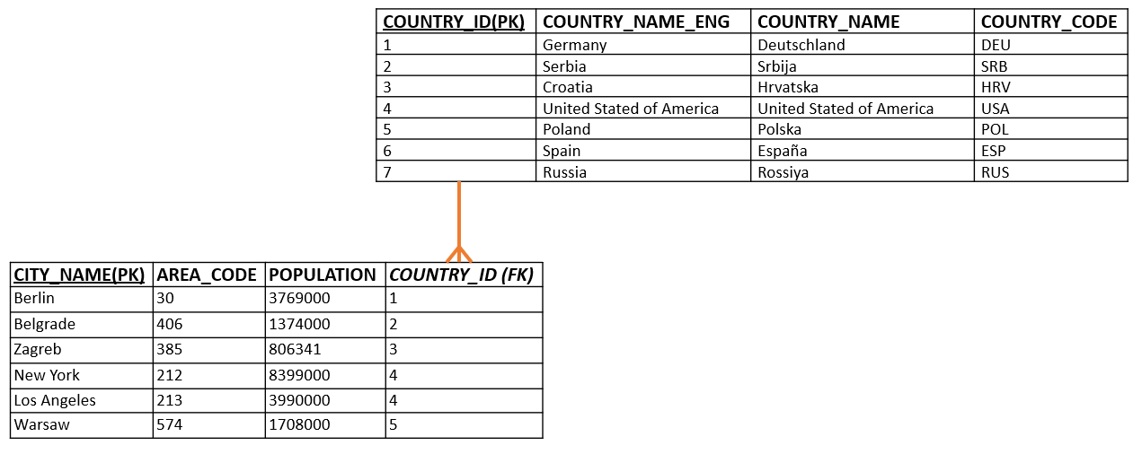
Practice
Consider the two tables below,
List All pairs of countries and cities that are related.

Slide 72
LEFT JOIN
Left Join returns all the rows of the table on the left side of the join and matching rows for the table on the right side of join.
The rows for which there is no matching row on right side, the result set will contain NULL.
Syntax:
SELECT column_name(s)
FROM tableL
LEFT JOIN tableR
ON tableL.column_name = tableR.column_name;

Slide 73
Left Table: Employee
Right Table: Department
EMPLOYEE_NO | EMPLOYEE_NAME | DEPARTMENT_NO
10001 | A Smith | 4
10030 | L Jones | 28
21010 | P Lewis | 4
10010 | B Jones | 4
31002 | T Gilbert | 28
13210 | W Richards | 28
10034 | B James | 9
10039 | T Small
DEPARTMENT_NO | DEPARTMENT_NAME
7 | Sales
10 | Equities
4 | Technology
23 | Pensions
28 | Database
8 | Salary
9 | HR
Employee LEFT JOIN Department
SQL:
SELECT e.Employee_Name, d.Department_Name
FROM Employee e
LEFT JOIN Department d
ON e.Department_No = d.Department_No;

Slide 74
Employee LEFT JOIN Department
Result set:
EMPLOYEE_NAME | DEPARTMENT_NAME
A Smith | Technology
P Lewis | Technology
B Jones | Technology
L Jones | Database
T Gilbert | Database
W Richards | Database
B James | HR
T Small | Null

Slide 75
Practice
Consider the two tables below, list all the names of countries and their cities. Make sure to list countries that have no related cities as well.

Slide 76
RIGHT JOIN
Right Join returns all the rows of the table on the right side of the join and matching rows for the table on the left side of join.
The rows for which there is no matching row on left side, the result set will contain NULL.
Syntax:
SELECT column_name(s)
FROM tableL
RIGHT JOIN tableR
ON tableL.column_name = tableR.column_name;

Slide 77
Left Table: Employee
Right Table: Department
EMPLOYEE_NO | EMPLOYEE_NAME | DEPARTMENT_NO
10001 | A Smith | 4
10030 | L Jones | 28
21010 | P Lewis | 4
10010 | B Jones | 4
31002 | T Gilbert | 28
13210 | W Richards | 28
10034 | B James | 9
10039 | T Small
DEPARTMENT_NO | DEPARTMENT_NAME
7 | Sales
10 | Equities
4 | Technology
23 | Pensions
28 | Database
8 | Salary
9 | HR
Employee RIGHT JOIN Department
SQL:
SELECT e.Employee_Name, d.Department_Name
FROM Employee e
RIGHT JOIN Department d
ON e.Department_No = d.Department_No;

Slide 78
Employee RIGHT JOIN Department
Result set:
EMPLOYEE_NAME | DEPARTMENT_NAME
A Smith | Technology
L Jones | Database
P Lewis | Technology
B Jones | Technology
T Gilbert | Database
W Richards | Database
B James | HR
Null | Pensions
Null | Sales
Null | Salary
Null | Equities

Slide 79
Practice
Consider the two tables below, list all the names of cities and the countries they belong to. Make sure to list cities that have no related countries as well.

Slide 80
FULL JOIN
Full Join returns all the rows from both the tables. The rows for which there is no matching, the result-set will contain NULL values
FULL JOIN can potentially return very large result-sets!
Syntax:
SELECT column_name(s)
FROM tableL
FULL JOIN tableR
ON tableL.column_name = tableR.column_name;

Slide 81
Left Table: Employee
Right Table: Department
EMPLOYEE_NO | EMPLOYEE_NAME | DEPARTMENT_NO
10001 | A Smith | 4
10030 | L Jones | 28
21010 | P Lewis | 4
10010 | B Jones | 4
31002 | T Gilbert | 28
13210 | W Richards | 28
10034 | B James | 9
10039 | T Small
DEPARTMENT_NO | DEPARTMENT_NAME
7 | Sales
10 | Equities
4 | Technology
23 | Pensions
28 | Database
8 | Salary
9 | HR
Employee FULL JOIN Department
SQL:
SELECT e.Employee_Name, d.Department_Name
FROM Employee e
FULL JOIN Department d
ON e.Department_No = d.Department_No;

Slide 82
Employee FULL JOIN Department
EMPLOYEE_NAME | DEPARTMENT_NAME
A Smith | Technology
L Jones | Database
P Lewis | Technology
B Jones | Technology
T Gilbert | Database
W Richards | Database
B James | HR
T Small | Null
Null | Pensions
Null | Sales
Null | Salary
Null | Equities
Result set:

Slide 83
Practice
Consider the two tables below, List all countries and all cities.
List all records from both tables. So, if there are rows in “Country” that do not have matches in “City", or if there are rows in “City" that do not have matches in “Country", those rows should be listed as well.

Slide 84
SQL Subqueries

Slide 85
SQL Subqueries
A subquery is a query within another query. The outer query is called the main query and inner query is called as subquery
A subquery is nested inside another statement such as SELECT, INSERT, UPDATE, or DELETE.
Subquery can be placed in: WHERE clause, HAVING clause, FROM clause.
The subquery executes first, and its output is passed to the main query.
Subquery must be enclosed in parentheses.
Subqueries can return individual values or a list of records.
Syntax:
SELECT column-names
FROM table-name1
WHERE column_name expression operator (SELECT column-name
FROM table-name2
WHERE condition);

Slide 86
SQL Subqueries
Consider the project table below, which projects have a Budget greater than the Salaries System’s budget?
Project Code | Project_Title | Project_Manager | Project_Budget
10 | Pensions System | M Phillips | 24500
45 | Salaries System | H Martin | 17400
64 | HR System | K Lewis | 12250
74 | Payroll System |  | 18500

Slide 87
SQL Subqueries - Example
Main query:
Which projects have a budget greater than “Salaries System” budget?
Subquery:
What is “Salaries System” budget?
To solve this problem, we need two queries: one query to find the Salaries System’s budget and a second query to find projects with budgets greater than that budget.

Slide 88
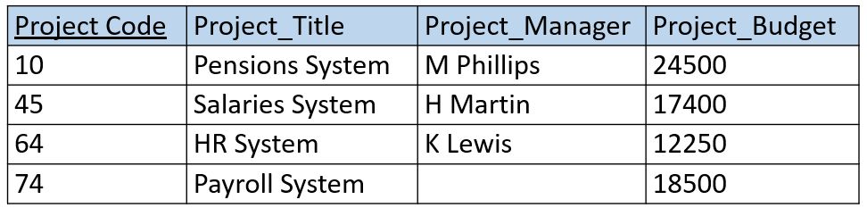
Using SQL Subqueries, cont…
Step1: Subquery
What is “Payroll System’s” budget?
(SELECT Project_Budget
FROM Project
WHERE Project_Title = ‘Payroll System’);
Step2: Main query
Which projects have a budget greater than “Payroll System’s” budget?
SELECT Project_Title
FROM Project
WHERE Project_Budget >
(SELECT Project_Budget
FROM Project
WHERE Project_Title = ‘Payroll System’);

Slide 89
Practice
Find country name associated with city ‘Berlin’.
Find country names (eng) having cities with area_codes = 406, 385, or 574.

Slide 90
INSERT WITH subquery
Syntax:
INSERT INTO Table2 SELECT * FROM Table1;
Example:
Write SQL code to copy table Employee into table Employee2
INSERT INTO Employee2 SELECT * FROM Employee;

Slide 91
UPDATE with subquery
Example: SET area code for all US cities to 718
    UPDATE City SET AREA_CODE = 718
    WHERE Country_ID = (SELECT Country_ID
    FROM Country
    WHERE Country_code = 'USA');

Slide 92
DELETE with subquery
Example: Delete all cities associated with country_code ‘DEU’ or ‘POL’
DELETE FROM City
WHERE Country_ID IN (SELECT Country_ID
FROM Country
WHERE Country_code = 'DEU'
OR Country_code = 'POL');

Slide 93
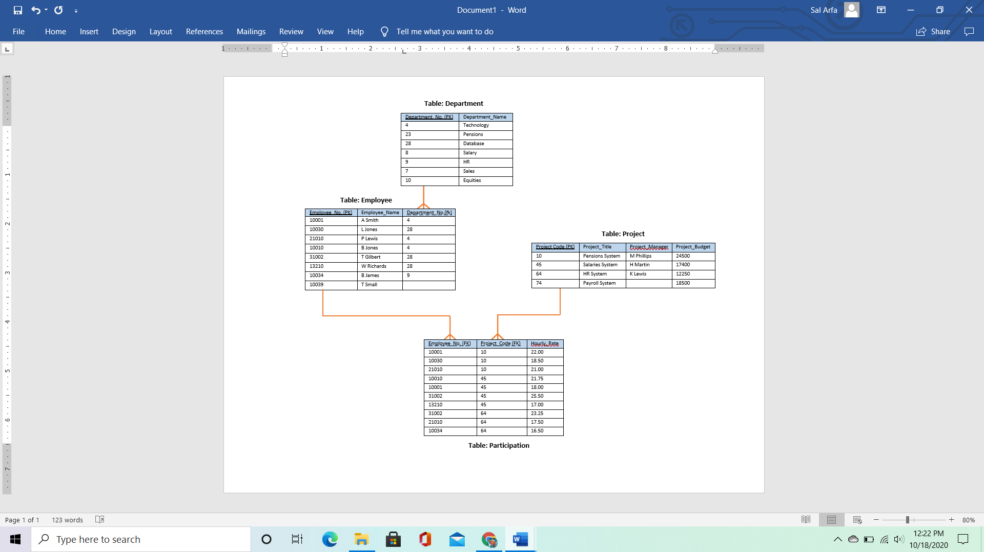
Challenge Questions
List all employee names participating in the 'HR System' project.
Find Project Managers for projects having employees from the technology department participating in.
Find the department names having an employee participating in a project managed by 'K Lewis'

